Slide 1


Unsupervised ML Classification Capstone Project
Book Recommendation System
Suraj Kad
Suraj.kad.90@gmail.com

Slide 2
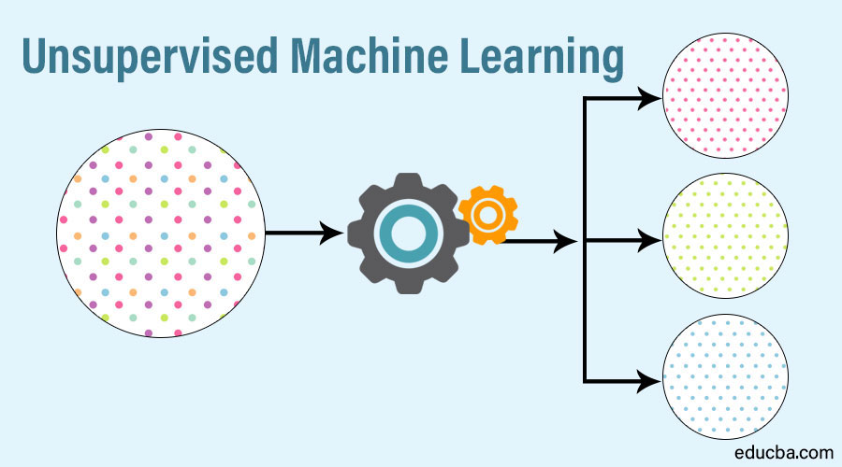
Unsupervised learning
Unsupervised learning is a type of algorithm that learns patterns from untagged data. The hope is that through mimicry, which is an important mode of learning in people, the machine is forced to build a concise representation of its world and then generate imaginative content from it.

Slide 3


Problem Statement
During the last few decades, with the rise of YouTube, Amazon, Netflix, and many other such web services, recommender systems have become much more important in our lives in terms of providing highly personalized and relevant content.
The main objective is to create a recommendation system to recommend relevant books to users based on popularity and user interests.

Slide 4
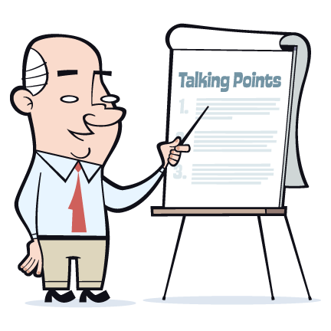
Content
● Problem statement
● Data Summary
● Data Cleaning
● Imputing missing values
● Analysis of different datasets
● Different Recommendation Model
● Challenges
● Conclusion
● Future Scope

Slide 5
Data Summary
The dataset is comprised of three csv files:: User_df, Books_df, Ratings_df
Users_dataset.
● User-ID (unique for each user)
● Location (contains city, state and country separated by commas)
● Age
Shape of Dataset - (278858, 3)
Books_dataset.
● ISBN (unique for each book)
● Book-Title
● Book-Author
● Year-Of-Publication
● Publisher
Shape of Dataset - (271360, 8)
Ratings_dataset.
● User-ID
● ISBN
● Image-URL-S
● Image-URL-M
● Image-URL-L
● Book-Rating
Shape of Dataset - (1149780, 3)

Slide 6
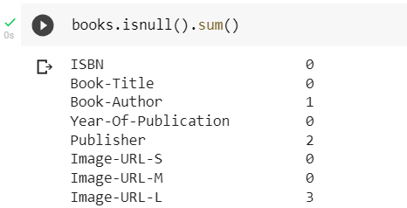
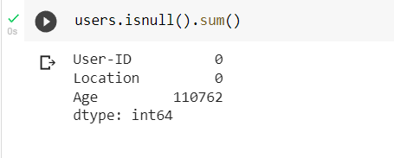
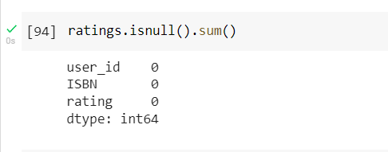
Data Preprocessing
Data Cleaning 1.
Null Value Imputation:
Books_dataset
Users_dataset
Ratings_dataset
As we can see in the output, books.isnull().sum()
Function has return Book-Author columns 1 NaN ,Publisher columns 2 NaN and Image-URL-L columns 3NaN data are present
As we can see in the output, Users.isnull().sum()
Function has return Age columns 110762 NaN data are present
As we can see in the output, ratings.isnull().sum()
Function has Not NaN data are present

Slide 7
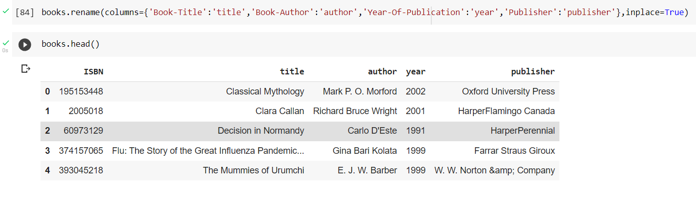
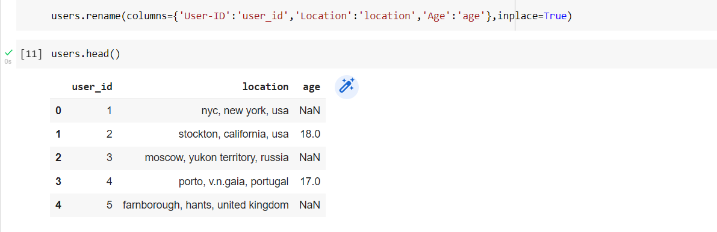
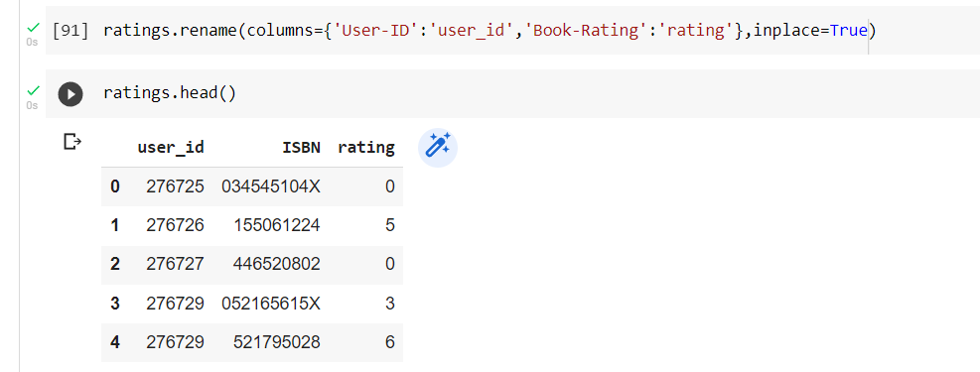
Features Engineering :
Change the columns name for better reliability
Users_dataset
Books_dataset
Ratings_dataset

Slide 8
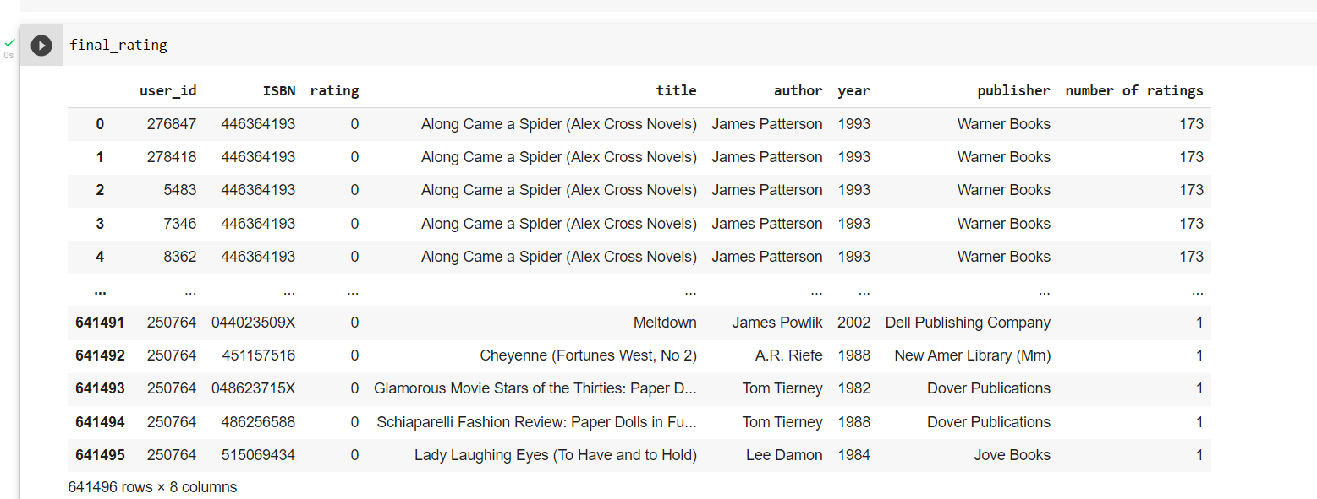
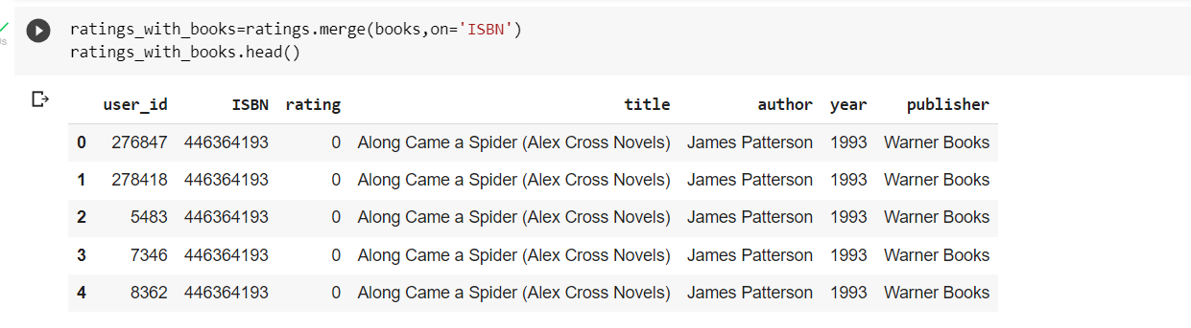
Marge Datasets:
Create New Features:

Slide 9
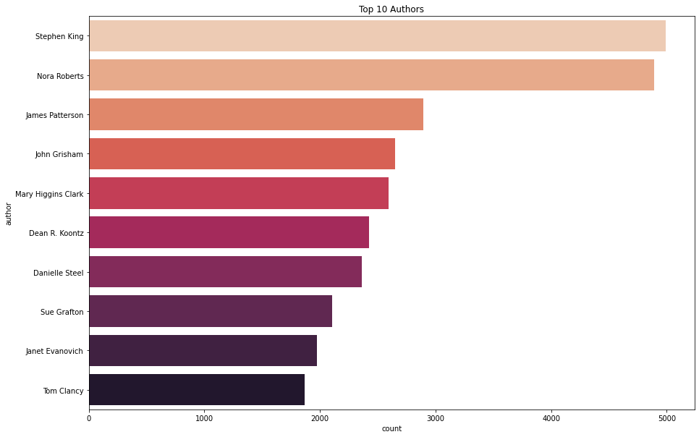
Exploratory Data Analysis (EDA)
● Observations from Top 10 Authors
Author Stephen King highest number of books in our given dataset

Slide 10
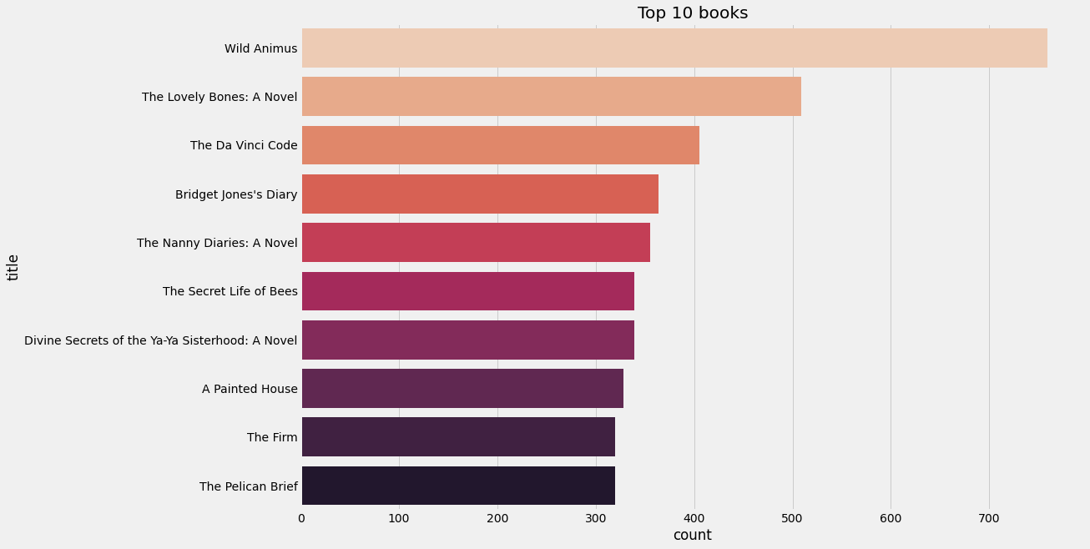
● Observations from Top 10 Books
Wild Animal highest number of books in our given dataset

Slide 11
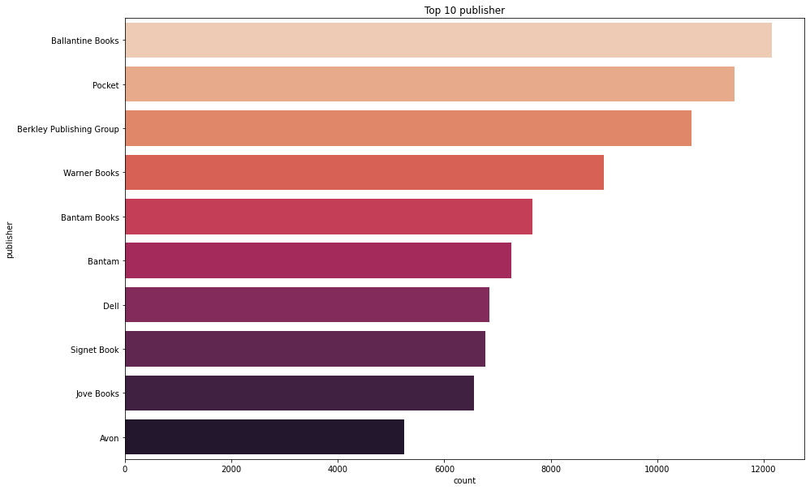
● Observations from Top 10 publisher
Ballantine Books published highest number of books in our given dataset

Slide 12
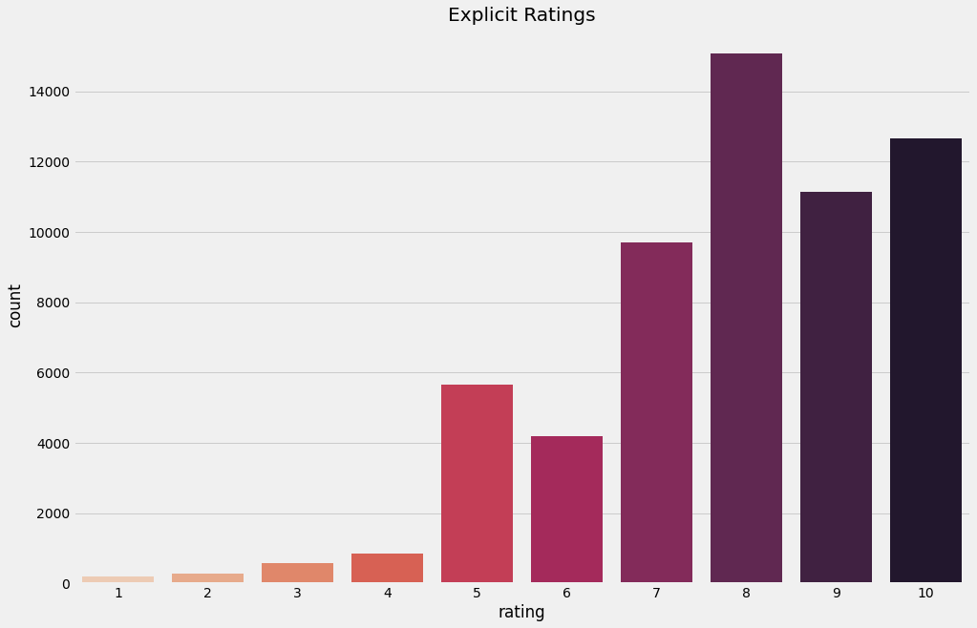
● Observations from Book Ratings.
● Higher ratings are more common amongst users
● Rating 8 has been rated the highest number of times

Slide 13
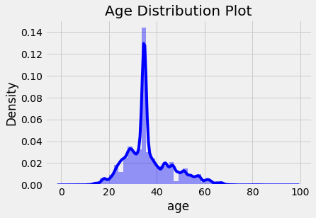
● Age Distribution.
● The Age range distribution is right skewed
● Most active readers lie in age group 20- 60

Slide 14
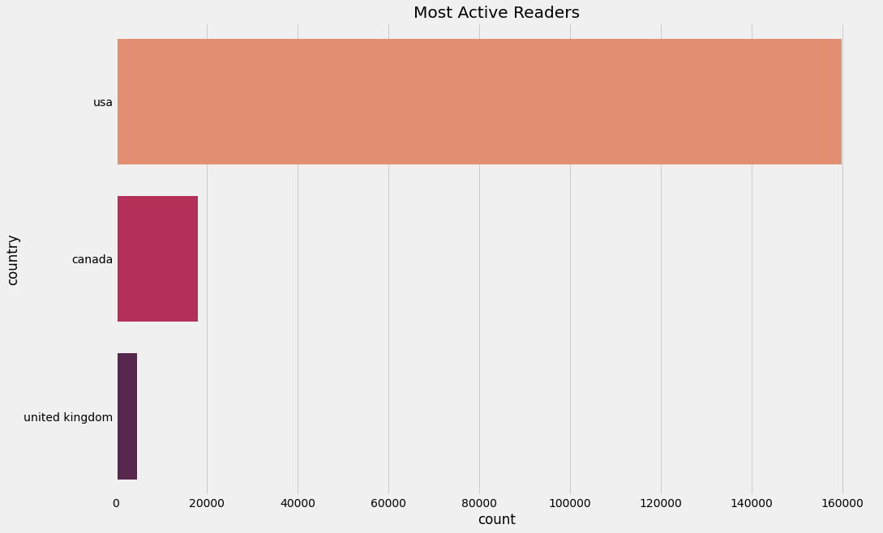
● Observations from Most Active Readers.
● Splitting Location column and analyzing country.
● Most active readers are from USA.

Slide 15
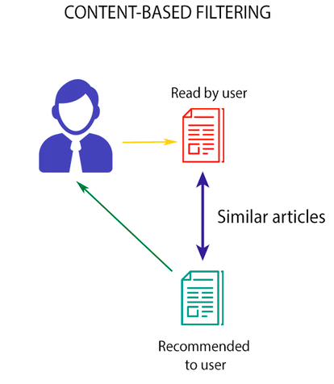
Recommendation Systems
Content Based Filtering :
Content-based filtering uses item features to recommend other items similar to what the user likes, based on their previous actions or explicit feedback.

Slide 16





Different Models Test set:
Actual Popularity Based top rated books
RECOMMENDATIONS
RECOMMENDATIONS
RECOMMENDATIONS
RECOMMENDATIONS
RECOMMENDATIONS
Wild Animus
The Lovely Bones: A Novel
The Da Vinci Code
Bridget Jones's Diary
The Nanny Diaries: A Novel

Slide 17




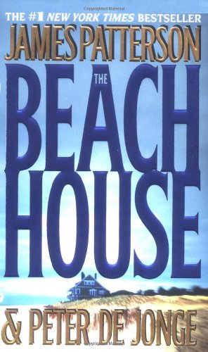
Different Models Test set:
Author Based Recommendation Systems
Author Name: James Patterson
RECOMMENDATIONS
RECOMMENDATIONS
RECOMMENDATIONS
RECOMMENDATIONS
RECOMMENDATIONS
1st to Die: A Novel
When the Wind Blows
Violets Are Blue
Suzanne's Diary for Nicholas
The Beach House

Slide 18
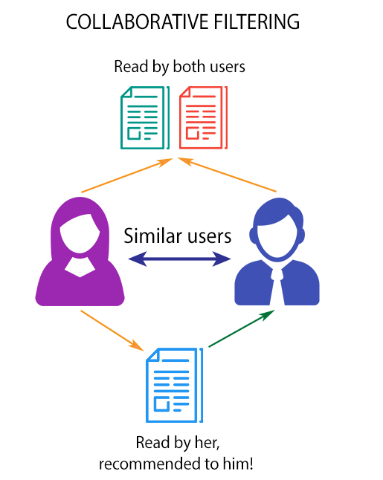
Recommendation Systems
Collaborative Filtering:
Collaborative filtering is a technique that can filter out items that a user might like on the basis of reactions by similar users
Model Implementation
Collaborative Filtering (User-Item Filtering)
Collaborative Filtering (Correlation Based)
Collaborative Filtering (Nearest Neighbor's Based)

Slide 19

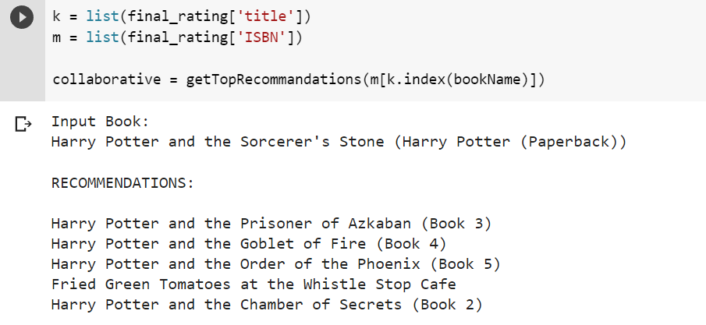





Collaborative Filtering (User-Item Filtering)
INPUT BOOK
RECOMMENDATIONS

Slide 20

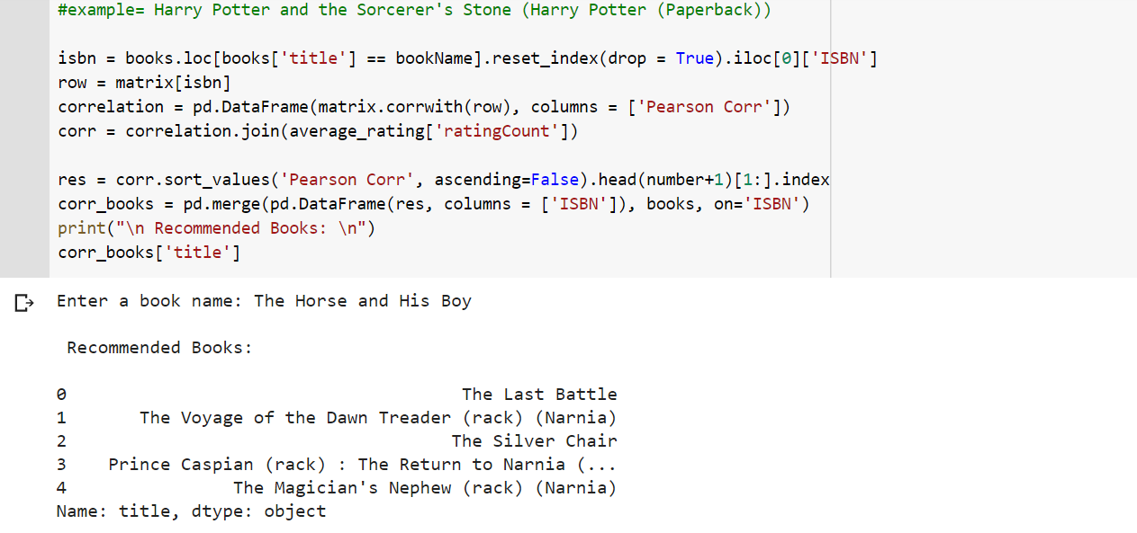
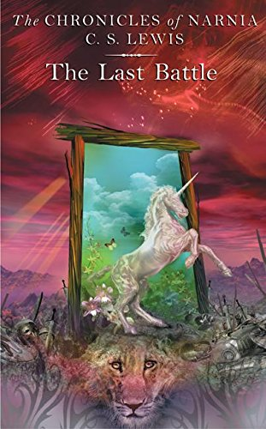



Collaborative Filtering (Correlation Based)
INPUT BOOK
RECOMMENDATIONS

Slide 21
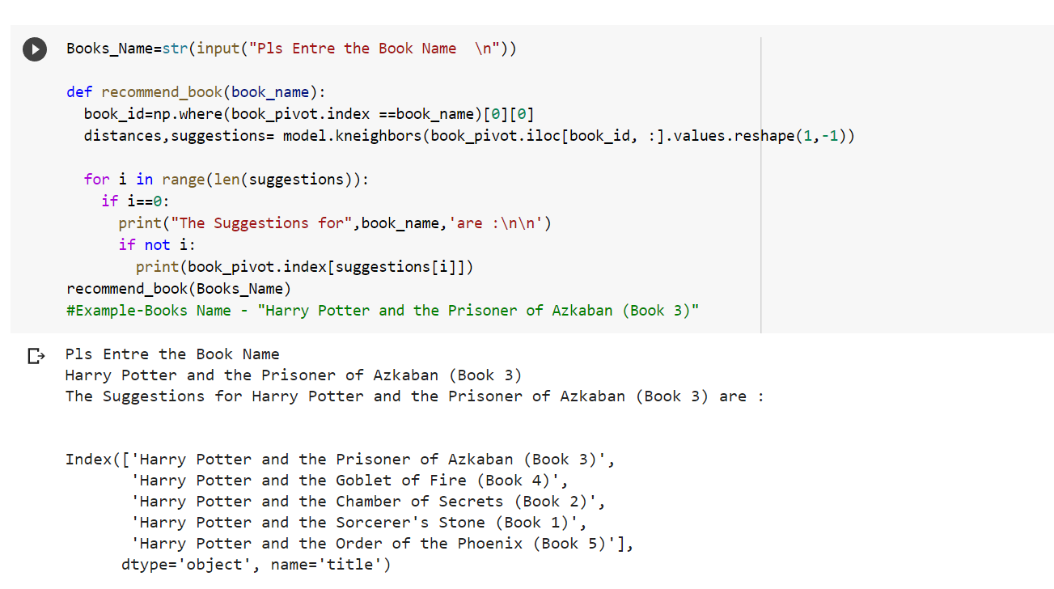

Collaborative Filtering (Nearest Neighbor's Based)
INPUT BOOK
RECOMMENDATIONS

Slide 22
Conclusion
In EDA, the Top-10 most rated books were essentially novels. Books like The Wild Animus and The Lovely Bones: A Novel .
Majority of the readers were of the age bracket 20-50 and most of them came from North American and European countries namely USA, Canada, UK.
If we look at the ratings distribution, most of the books have high ratings with maximum books being rated 8. Ratings below 5 are few in number.
Author with the most books was Stephen King, Nora Roberts and James Patterson.
A recommendation system helps an organization to create loyal customers. The recommendation system today are very powerful that they can handle the new customer too who has visited the site for the first time. They recommend the products which are currently trending or highly rated and they can also recommend the products which bring maximum profit to the company.

Slide 23
Challenges
● Handling of sparsity was a major challenge as well since the user interactions were not present for the majority of the books.
● Understanding the metric for evaluation was a challenge as well.
● Since the data consisted of text data, data cleaning was a major challenge in features like Location etc..
● Decision making on missing value imputations and outlier treatment was quite challenging as well.

Slide 24
Future Scope
● Given more information regarding the books dataset, namely features like Genre, Description etc., we could implement a content-filtering based recommendation system and compare the results with the existing collaborative-filtering based system.
● We would like to explore various clustering approaches for clustering the users based on Age, Location etc., and then implement voting algorithms to recommend items to the user depending on the cluster into which it belongs.

Slide 25
Thank You

